Slide 1

Numerical Analysis For Machine Learning Project
Prof. Edie Miglio
Authors:
Silvia Marino – 10688672
Francesco Panebianco - 10632465

Slide 2
The Scope
Assigned classifiers:
K-Nearest Neighbours
Multiclass Support Vector Machine
Extra:
Nearest Centroid

Slide 3
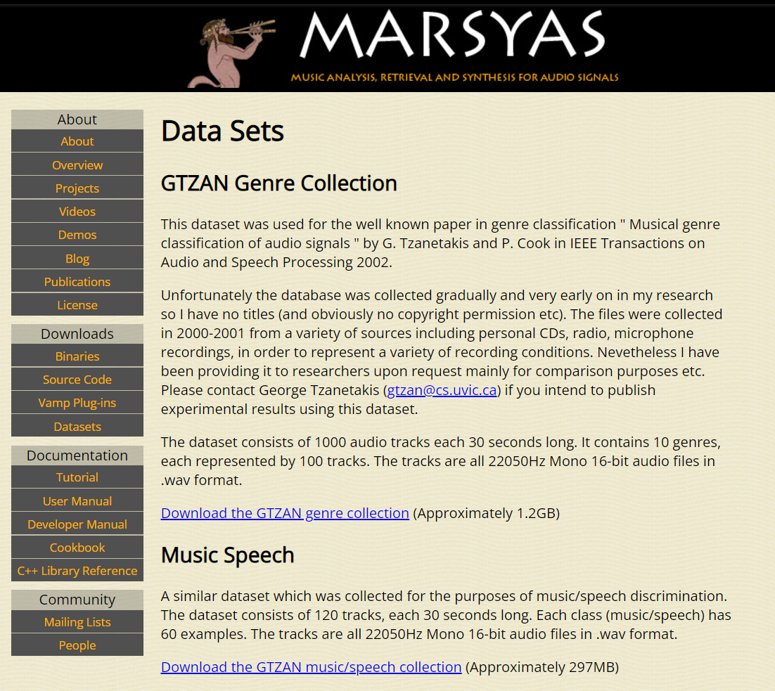
The Dataset

Slide 4
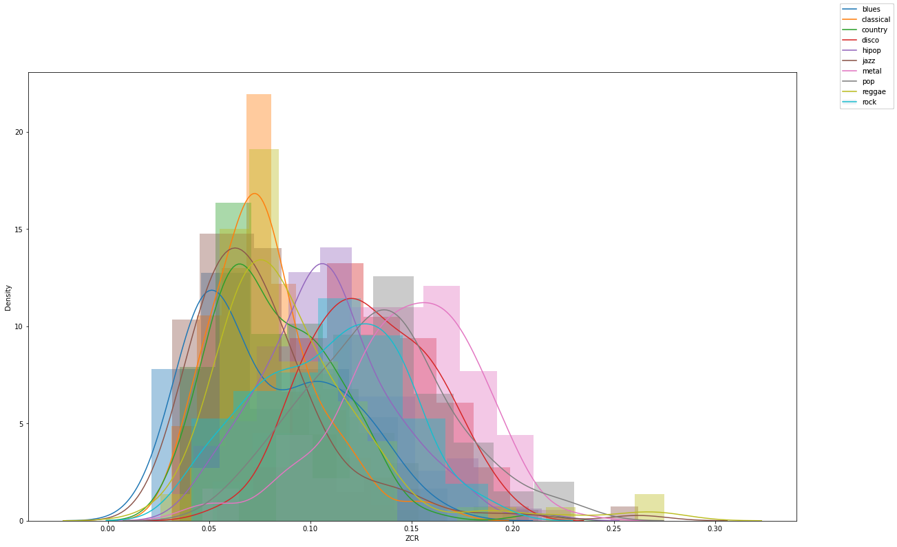
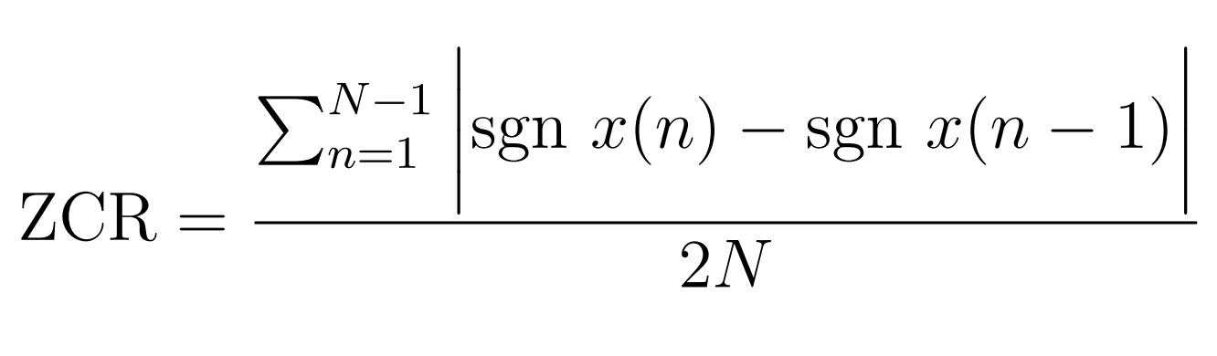
Zero-Crossing Rate

Slide 5
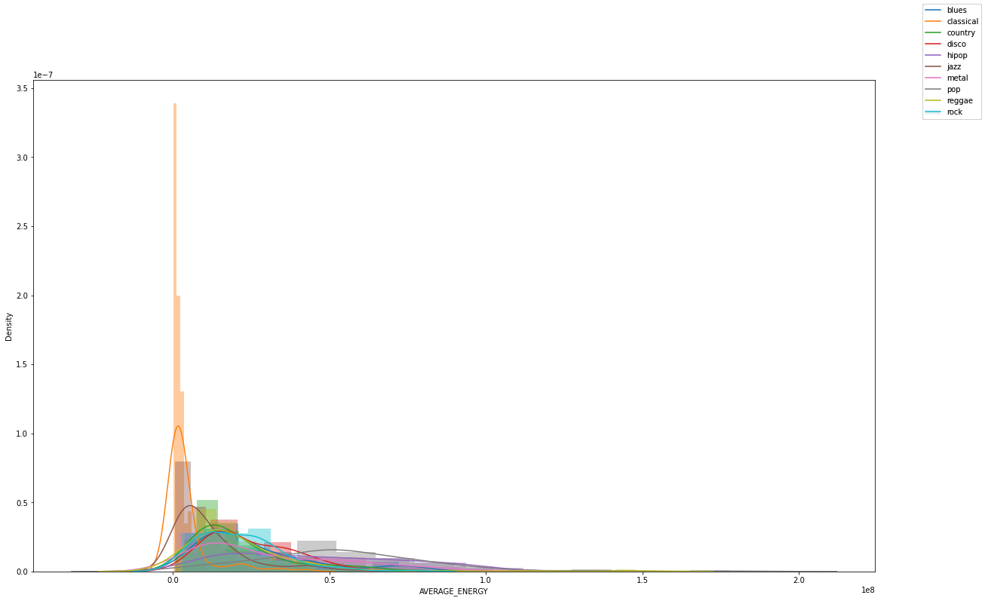
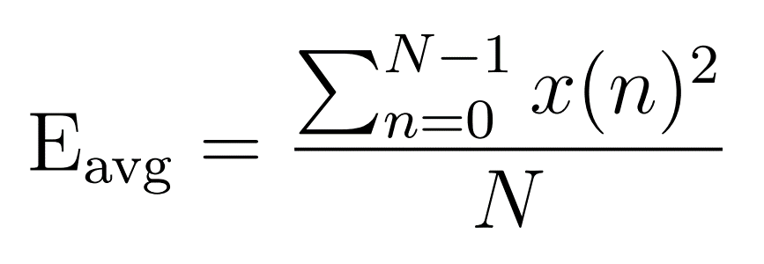
Average Energy

Slide 6
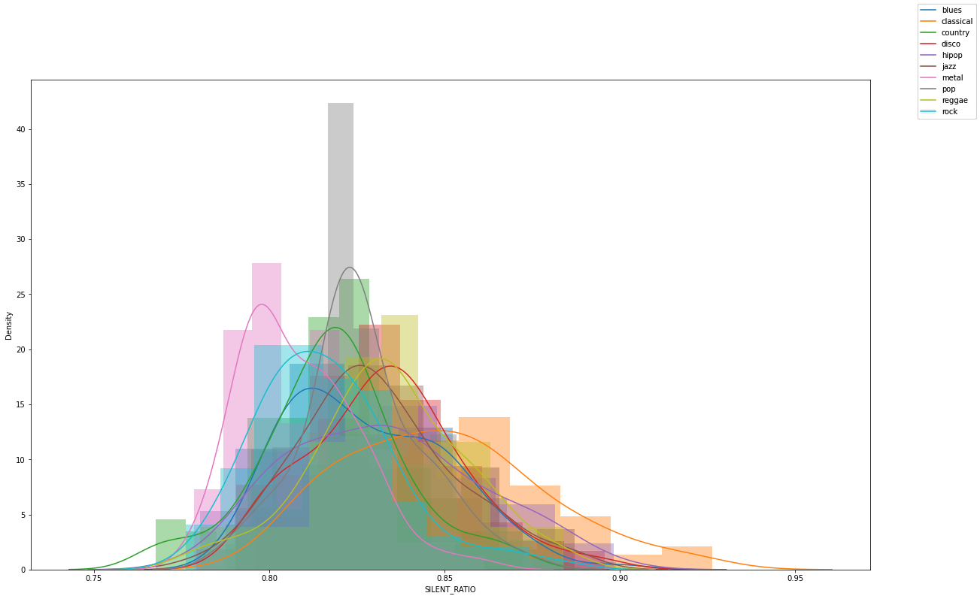
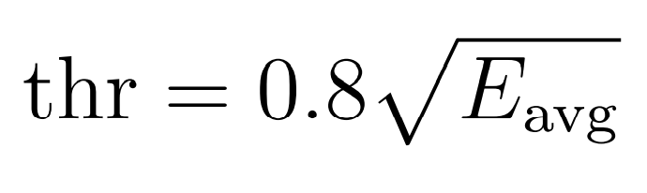
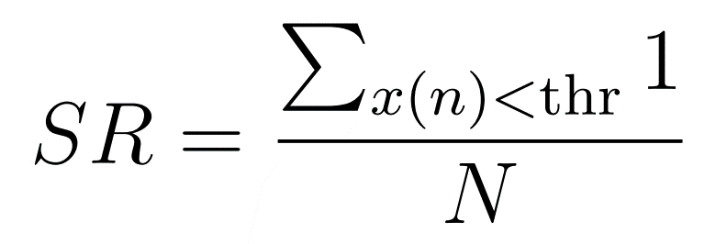
Silent Ratio

Slide 7
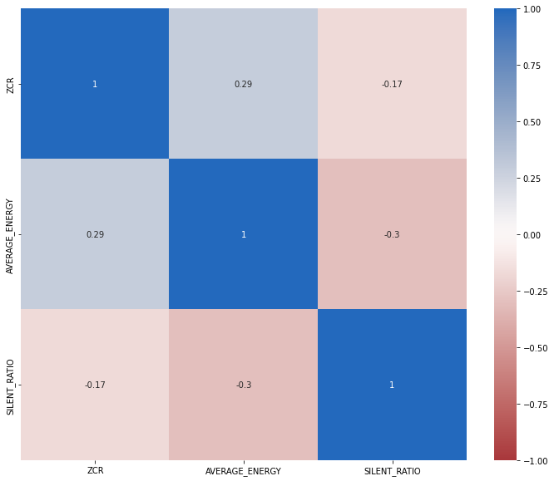
Correlation HeatMap

Slide 8
MFCC Extraction
Since a time series is provided, the spectrogram of the signal is computed.
The spectrogram is mapped to the mel scale
The log of the result is taken (dB conversion)
The Discrete Cosine Transform is applied

Slide 9
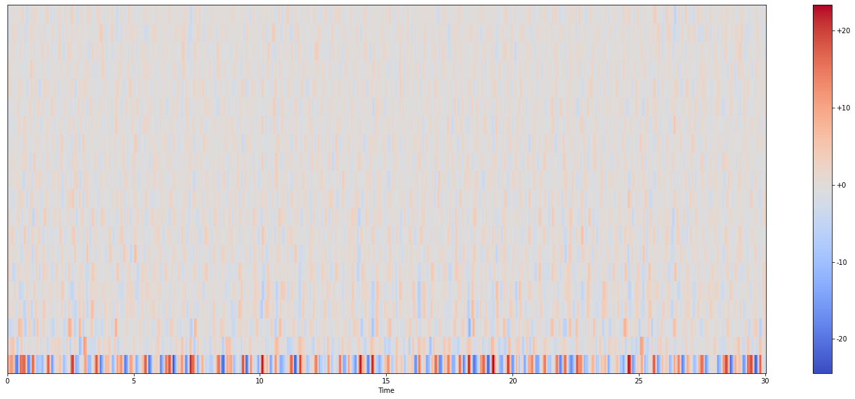
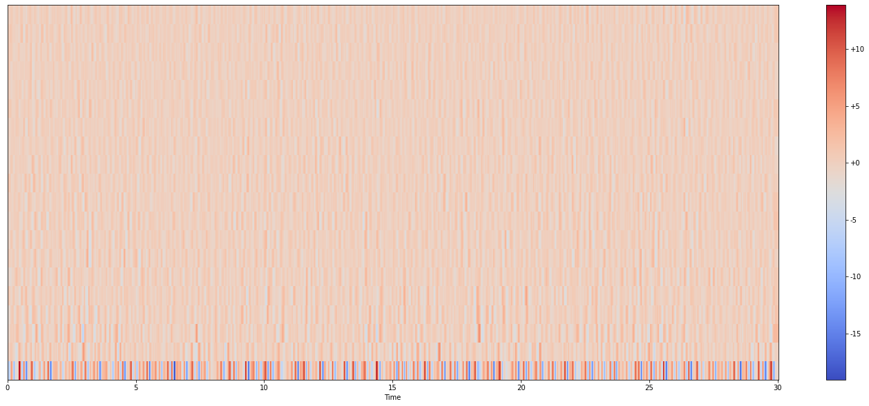
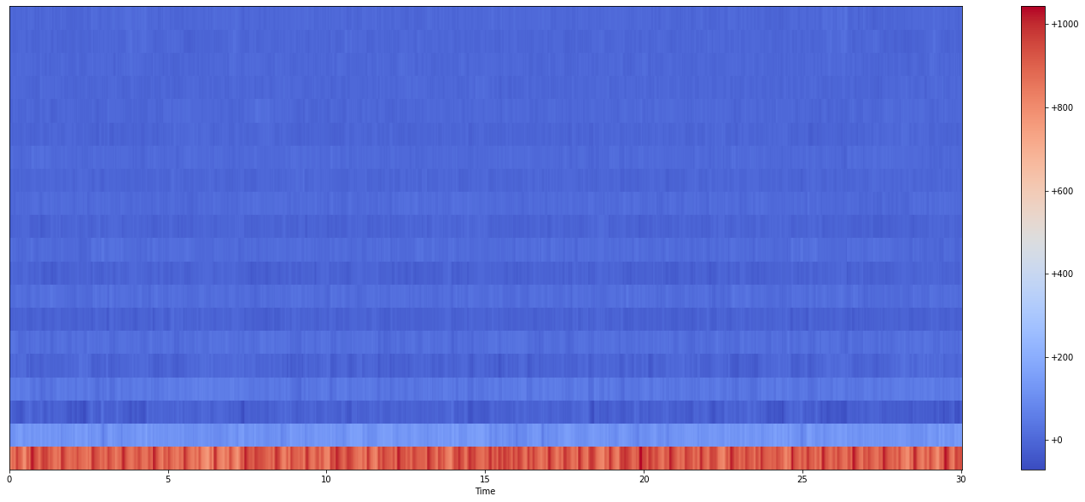
Mel-Frequency Cepstral Coefficients
Delta 1 Spectrogram
Delta 2 Spectrogram
MFCC Spectrogram

Slide 10
Distance based classifiers

Slide 11
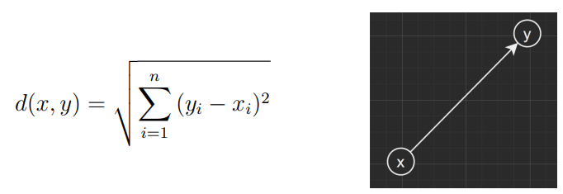
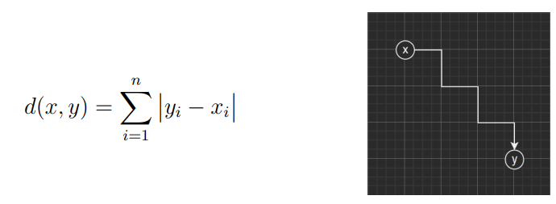
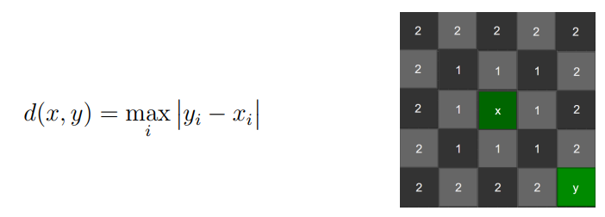
Distances
Euclidean distance
Manhattan distance
Chebyshev distance

Slide 12
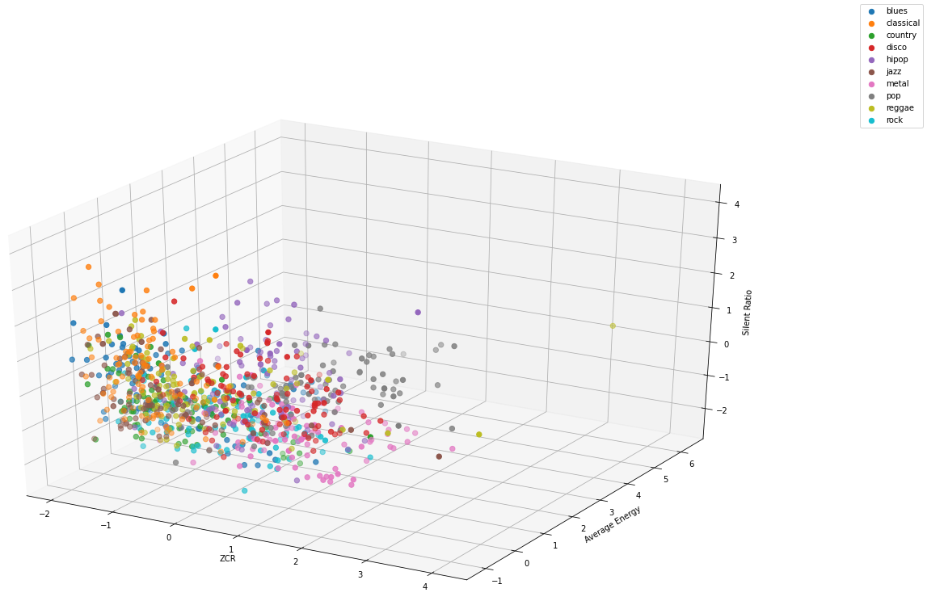
K-Nearest Neighbours
Picks the k nearest points in the dataset with respect to the input and returns the most frequent genre.

Slide 13
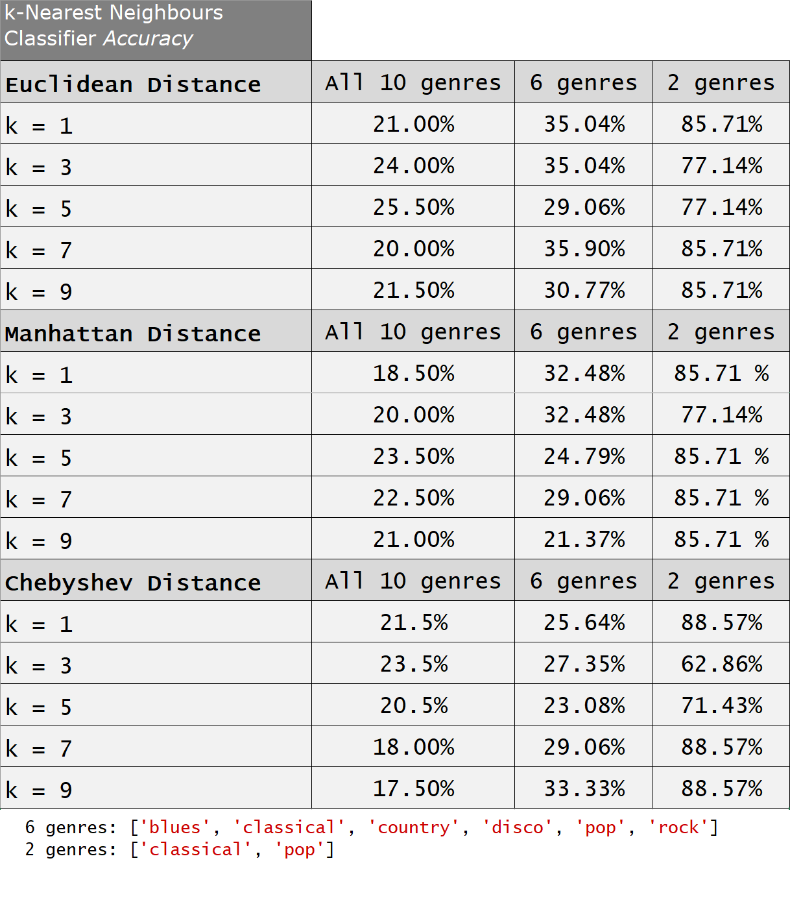
Computed accuracies

Slide 14
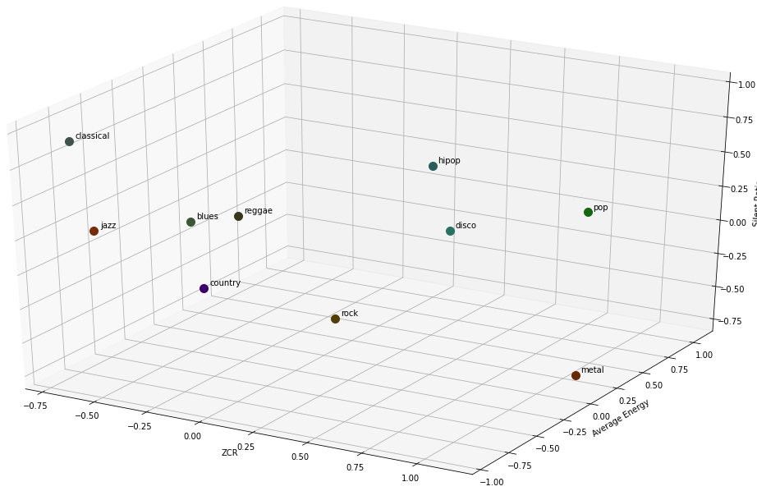
Nearest Centroid
Picks the nearest centroid with respect to the input and returns its genre.

Slide 15
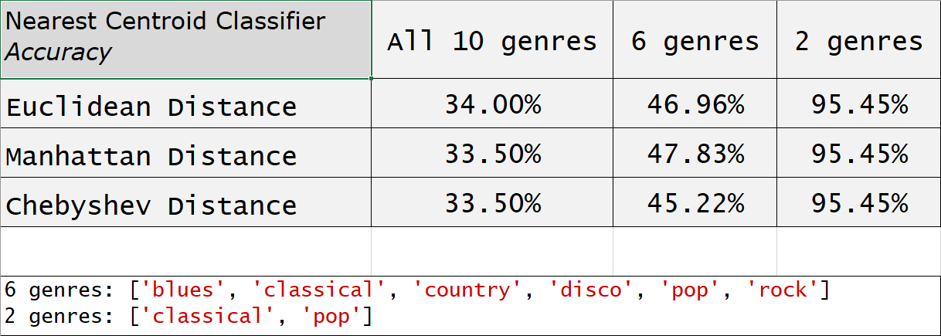
Computed accuracies

Slide 16
Support Vector Machine classifiers

Slide 17
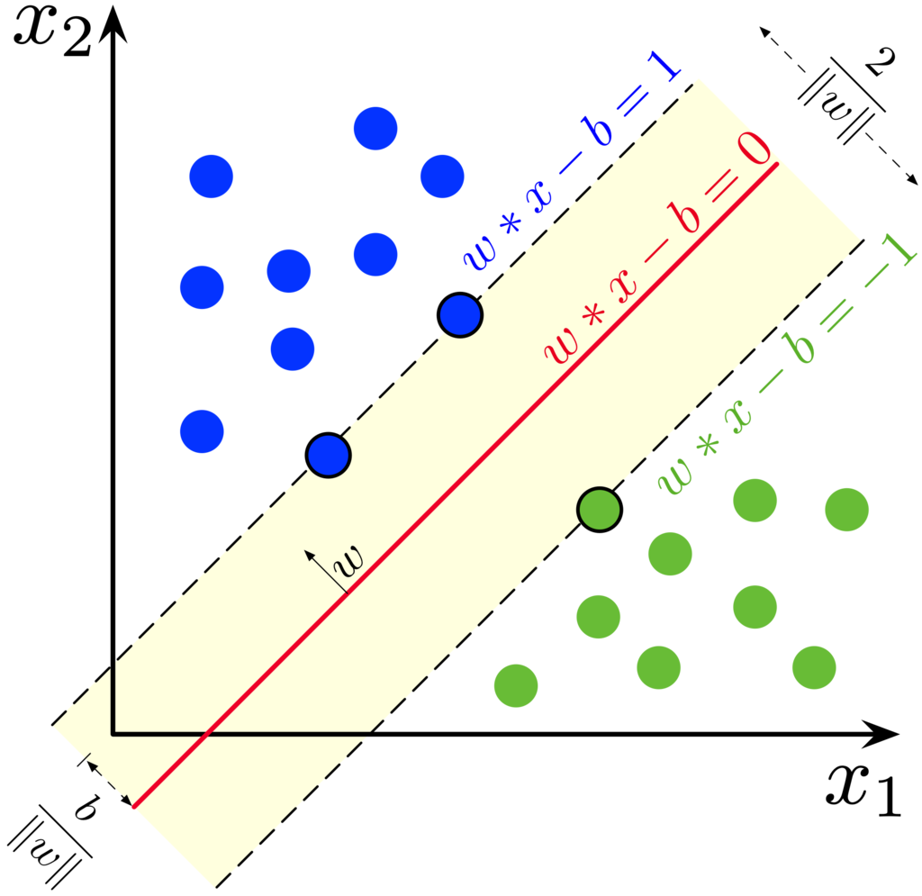
Support Vector Machine: Binary Classifiers
Now, we’ll introduce the building blocks models used for creating the multiclass classifiers.

Slide 18
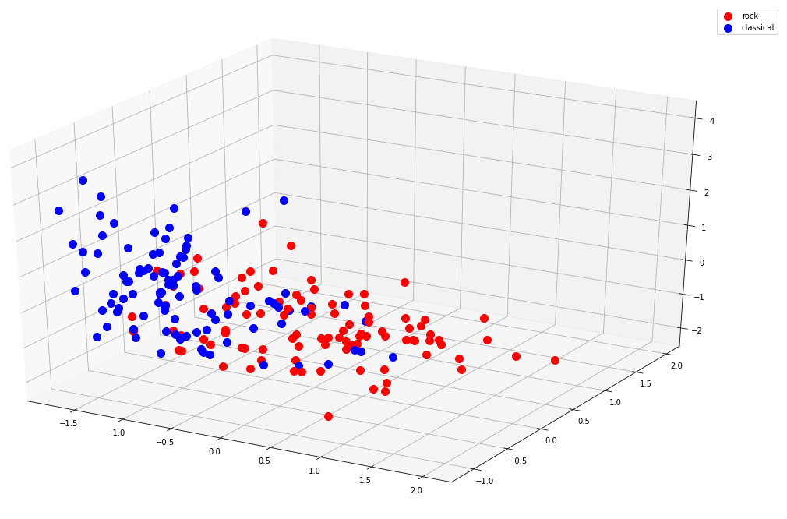
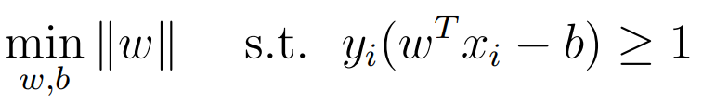
Primal Formulation: Hard Margin
Not implemented because the data is not linearly seperable

Slide 19
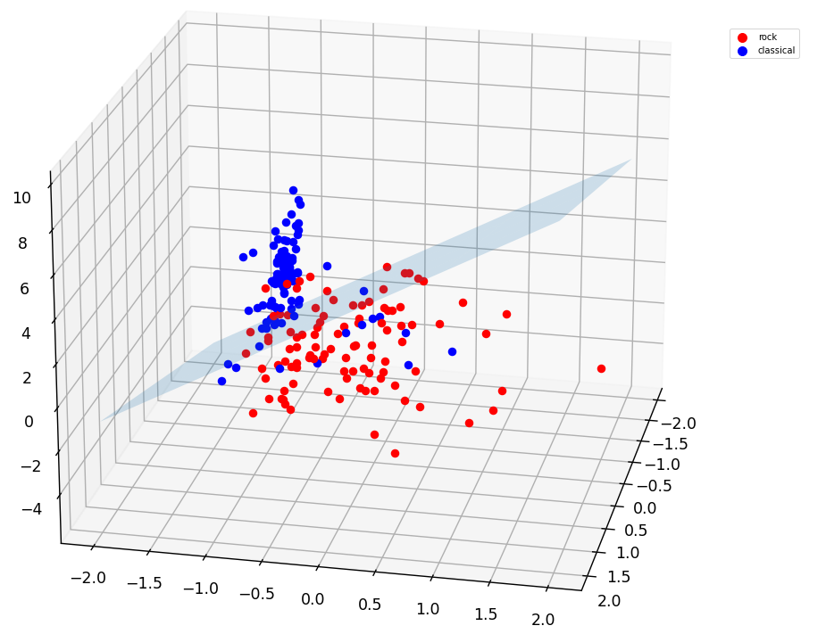
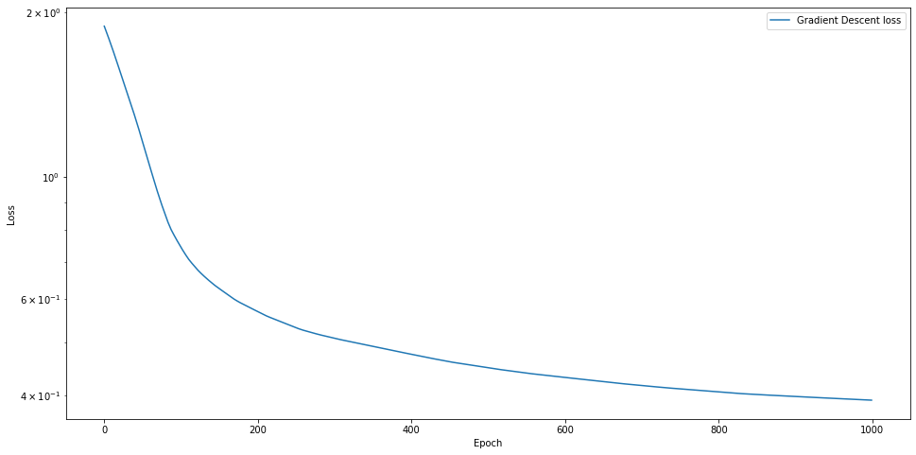
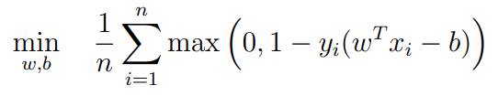
Primal Formulation: Soft Margin
It uses hinge loss function. Its optimization is unconstrained, so we use Gradient Descent…

Slide 20
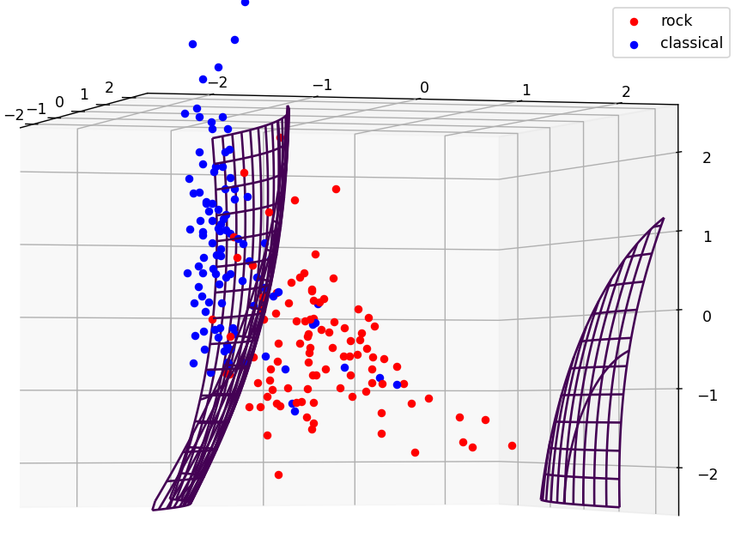
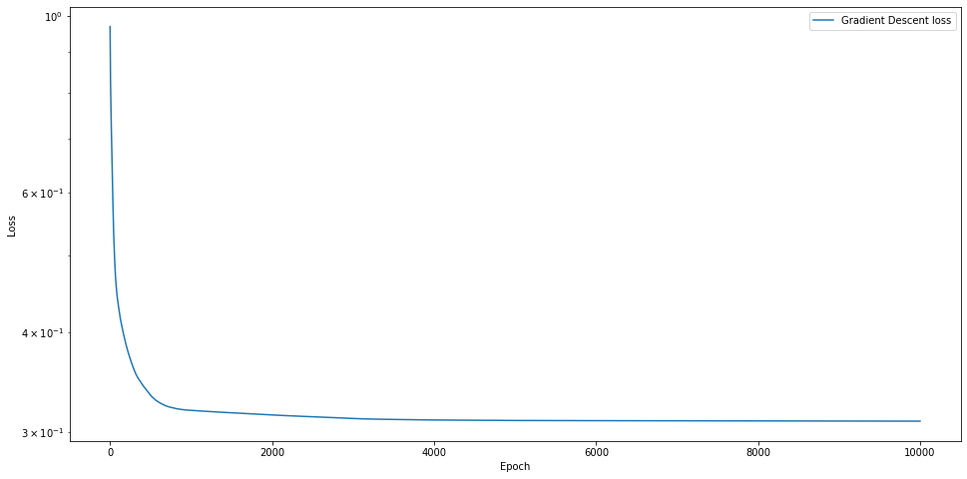
Primal Formulation: Soft Margin with Feature Map
Quadratic feature projection: performance increases substantially

Slide 21
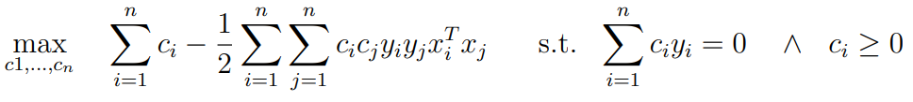
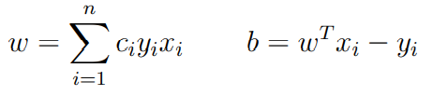
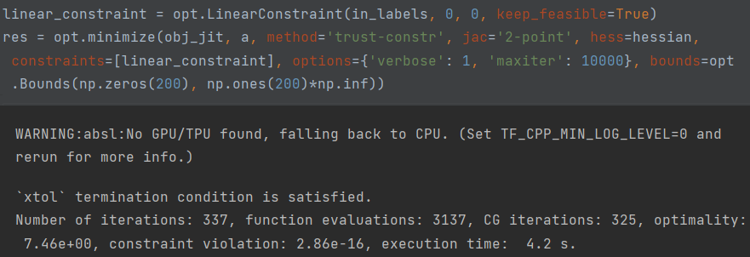
Dual Formulation: Linear Margin
Constrained optimization: quadratic programming.
We used scipy.optimize

Slide 22

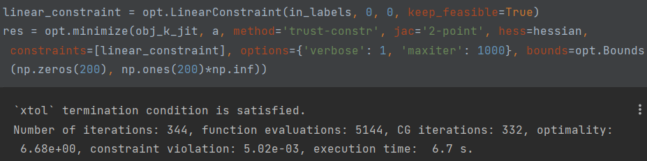
Dual Formulation: Non-Linear Margin Kernel Trick
Best performant kernel function:
We tried many kernel functions, but the one reported provided the best results. We also tried the gaussian kernel function, but the training time increased drammatically, so it was infeasible

Slide 23
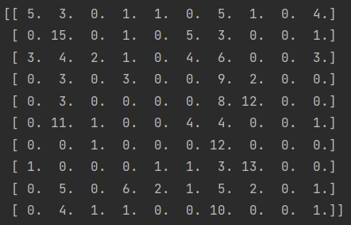
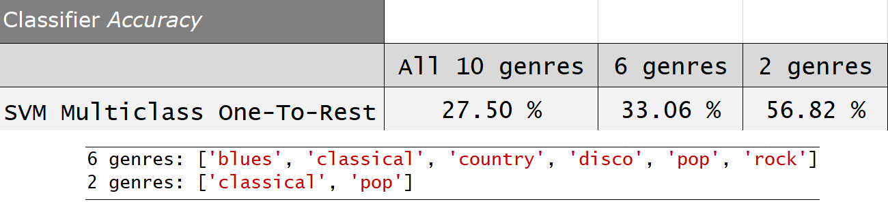
Multi class: One-To-Rest Accuracy
The binary solution of choice for this classifier is the dual formulation with kernel trick.
Confusion matrix for all ten genres

Slide 24
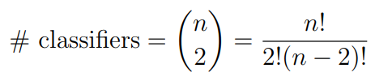
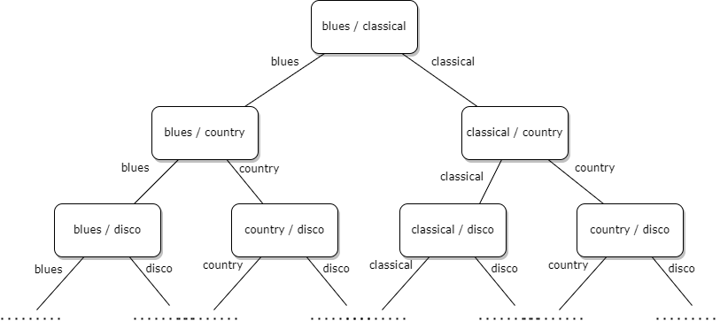
Multi class: One-To-One
The binary solution of choice for this classifier is the primal formulation with feature map.

Slide 25
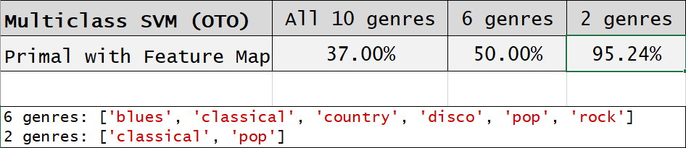
Computed accuracies

Slide 26
Alternative feature set: Mel Frequency Cepstral Coefficients

Slide 27
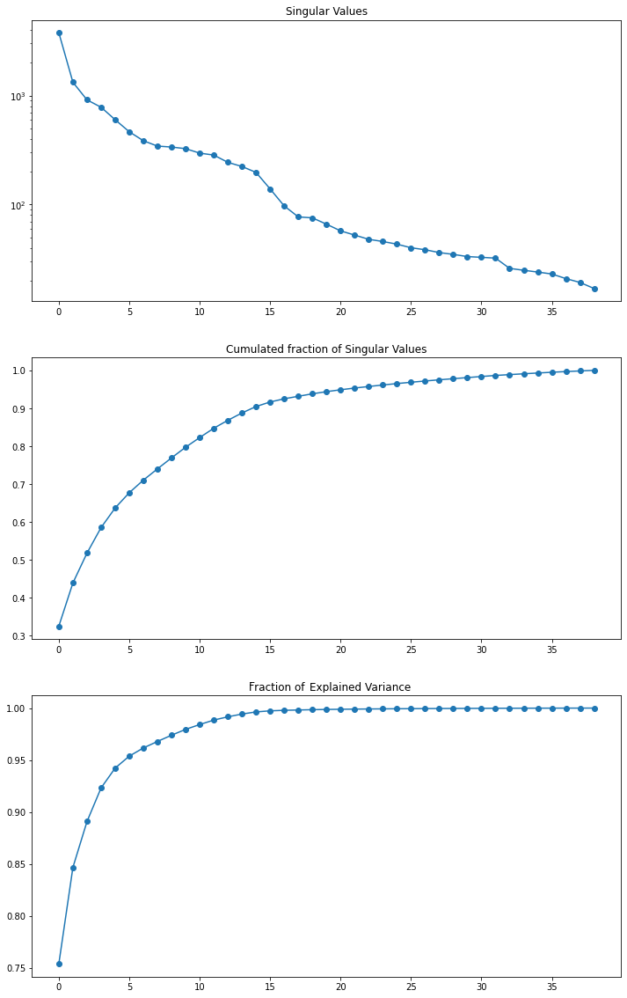
Principal Component Analysis
The complete feature set is redundant so we decided to apply the principal component analysis

Slide 28
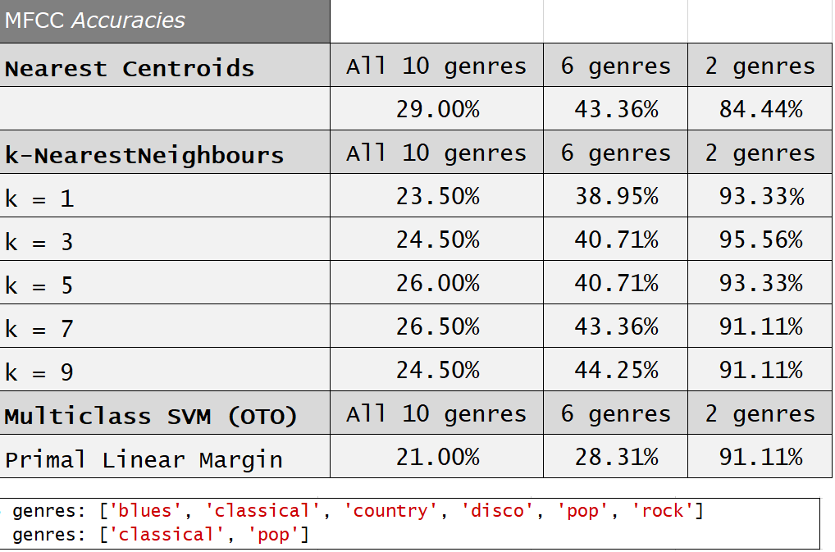
Computed accuracies

Slide 29
Thanks for your attention

